Slide 1
Zowe F2F meeting Intro session
Notes:
Closing Slide

Slide 2
Welcome!
Jean-Louis Vignaud

Slide 3
Bathrooms
Men’s Restroom
By the elevators, to the left
Women’s Restroom
By the elevators, to the right

Slide 4
Breakout Discussions
Sitting room by elevators
Kitchen - behind green wall
Need more? Ask a Broadcom employee

Slide 5
Snacks & Refreshments
Drinks & light snacks available in the room

Slide 6
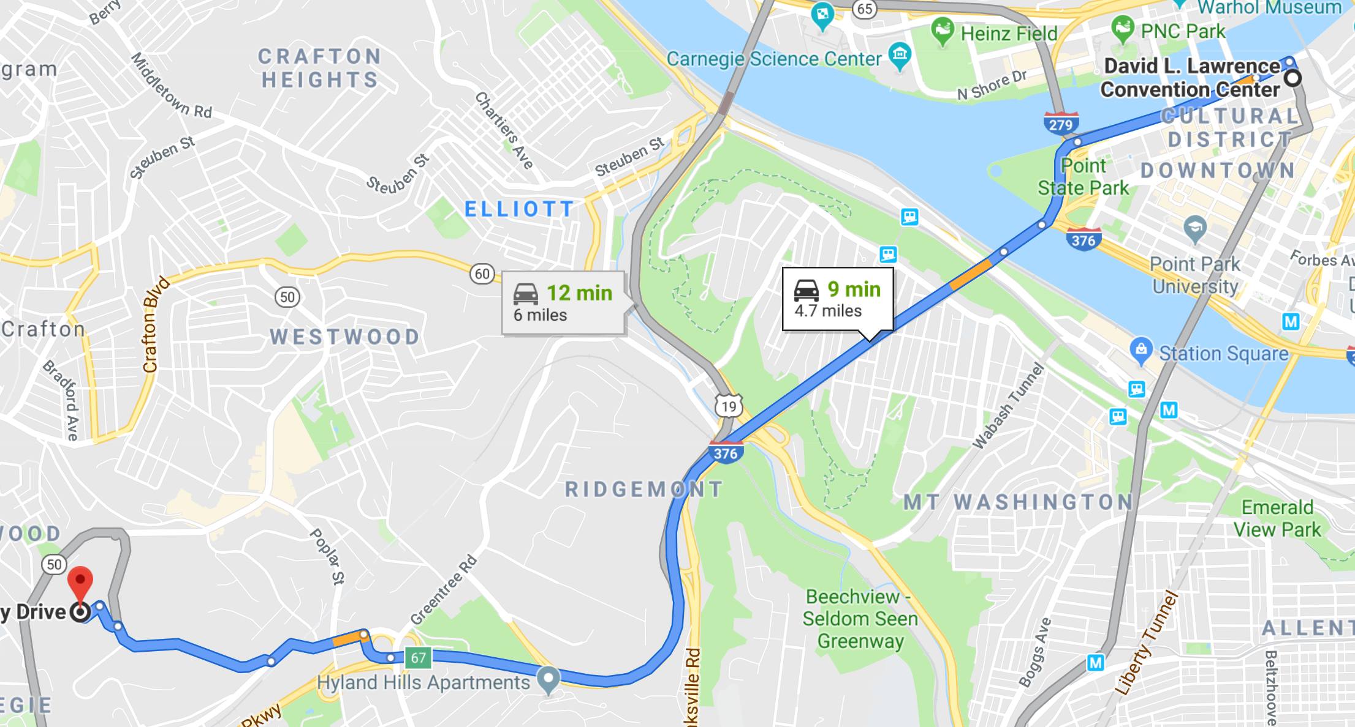
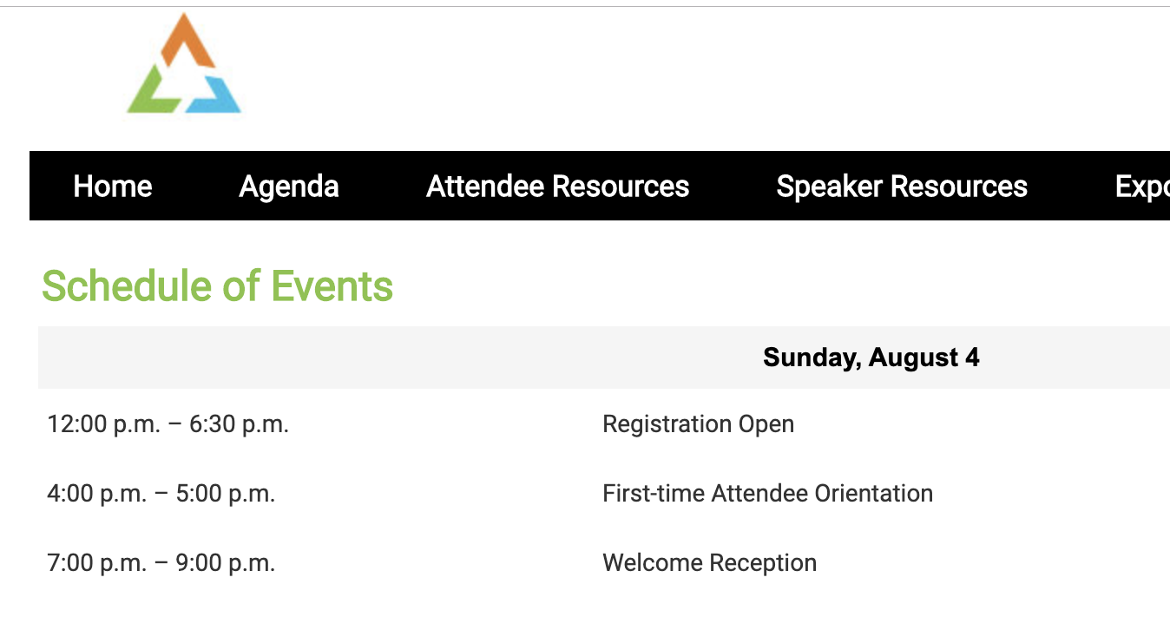
SHARE
First-time Attendee Orientation - 4:00p
Welcome Reception - 7:00p

Slide 7
Agenda
2:00-2:15: Introduction – Jean Louis Vignaud
2:15-2:45: Long Term Release Support – Bruce Armstrong
2:45-3:15: Zowe vNext (v2) – Mark Ackert (Sean Grady / Mike Bauer)
3:15-3:30 (BREAK) => First time SHARE attendees can decide to go to the SHARE Orientation session at 4pm
3:30-4:00: Conformance Program / App Directory – Tim Brooks
4:00-4:30: Developer Enablement / Advocacy – Matt Hogstrom Removed due to time
4:30-5:00: CI/CD Review – Mark Ackert (Alvin Tan)
=> SHARE attendees can go and register until 6:30pm – Welcome reception is at 7:00pm

Slide 8





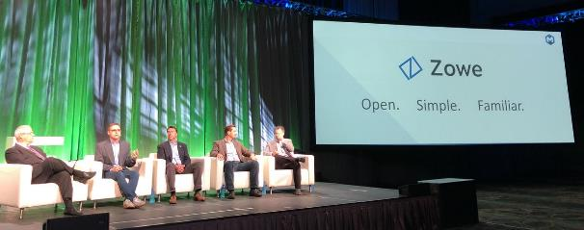
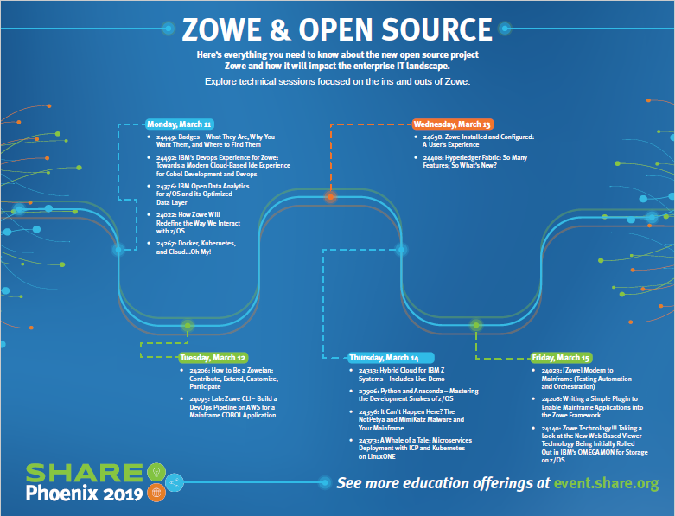

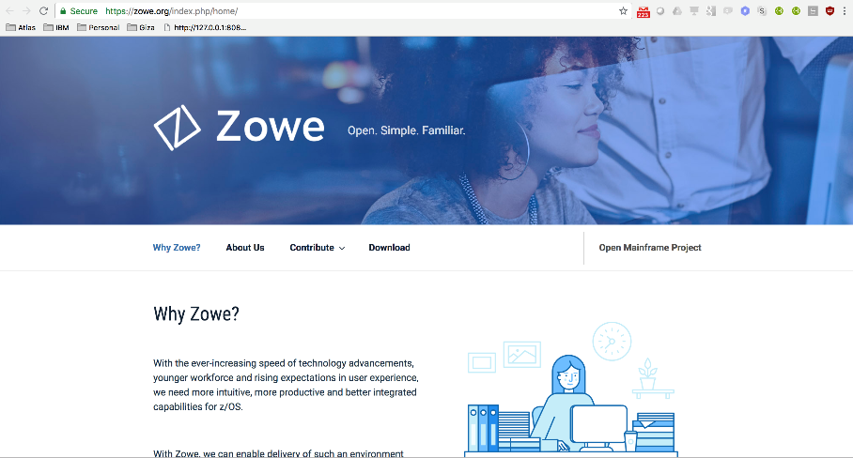
700
March
V1.3.0
GA June 13th 2019
EPL 2.0 license
1100+
Community Slack Members Engaged
25+
Apps, plug-ins and extensions
140+
Active committers.
4000+
Beta & GA Downloads
Notes:
Zowe reduces the time to on-board new developers and system programmers working on the Mainframe.
Zowe makes interacting with the mainframe feel like any modern cloud or desktop platform.
Zowe improves responsiveness to Line of Business requests and time to market by simplifying task and interactions.

Slide 9
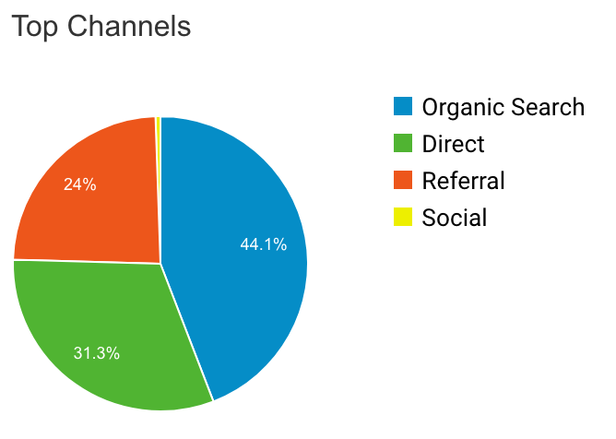
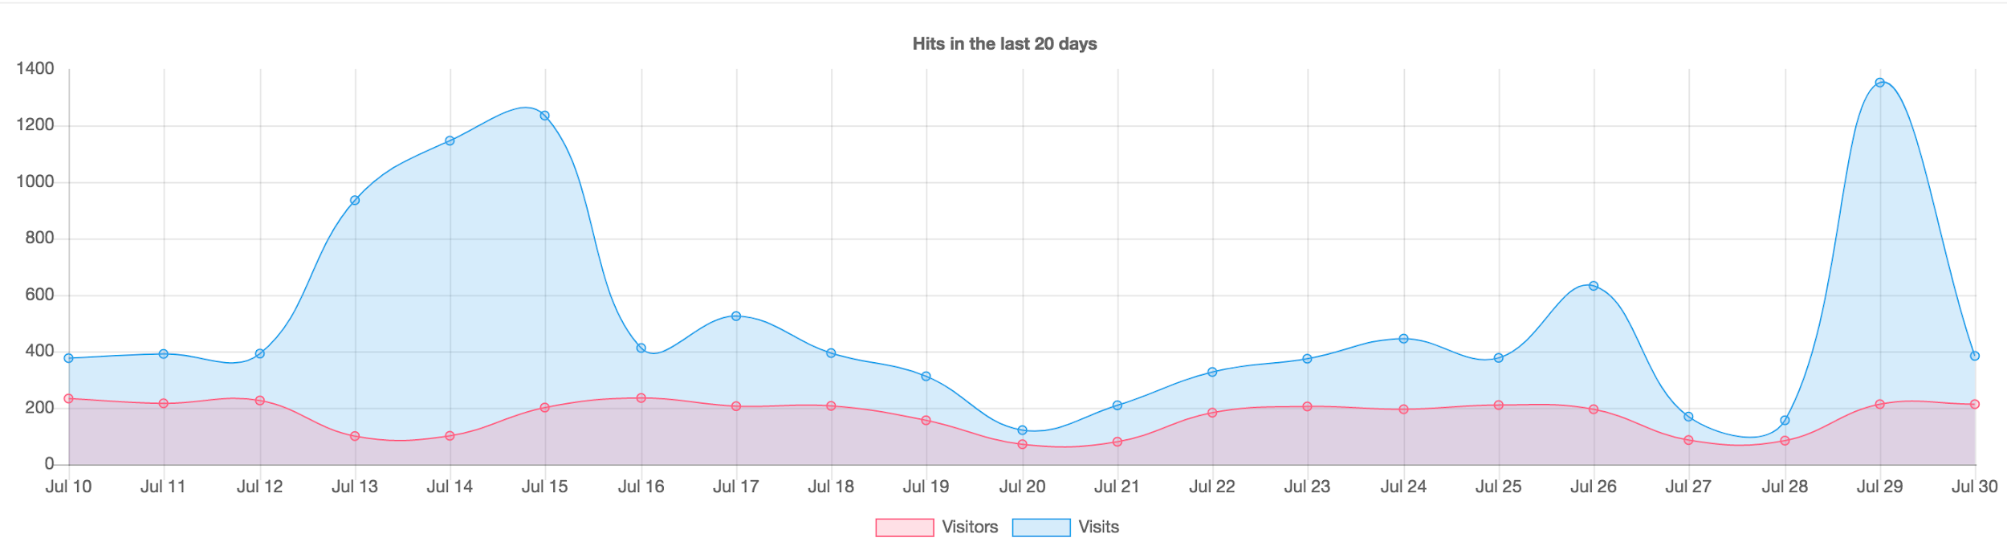
Zowe.org
62K Page Views
23.2%
Bounce Rate from homepage
- 3% (vs. previous 30 days)
3.4KUnique Visitors
+677K Cumulative Pageviews since Launch (Aug 13th, 2018)
4.40% of visitors go to the download page from homepage in 1st interaction
-1.05% decrease vs. previous 30 days
Avg 7.68 Pages/Session (+0.45 vs previous 30 days)
Demographics:
46.70% of site visitors are between the ages 18-34 (+1.42% vs previous 30 days)
82.4% male and 17.6% female
+0.91% (vs. previous 30 days)
-10% (vs. previous 30 days)
4m 21sAvg. Session
67% New Visitors
+16 sec (vs. previous 30 days)
-2% (vs. previous 30 days)
33% Returning Visitors
+2% (vs. previous 30 days)
Top Referral Sites:
Zowe.org (52%)
Projectgiza.org -download site (13%)
developer.ibm.com (6%)
Github.com (5%)
Metrics from Google Analytics
Last 20 days Visitors: 3,616
Visits: 10,664

Slide 10
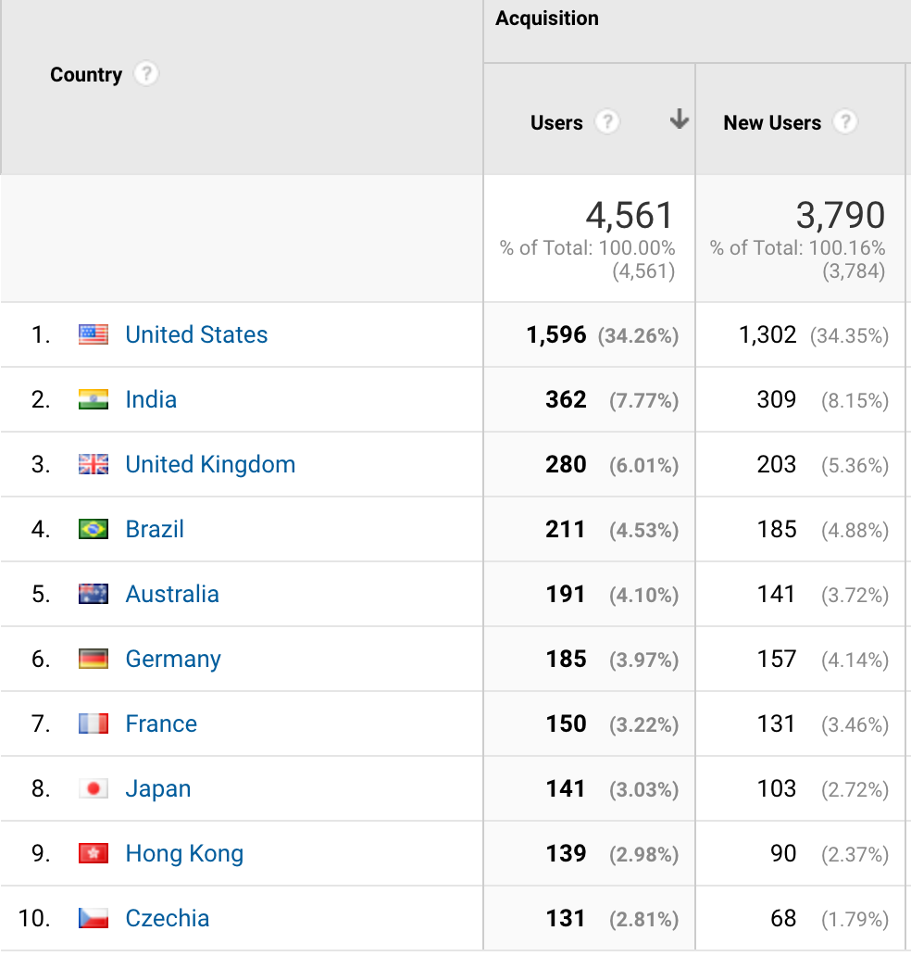
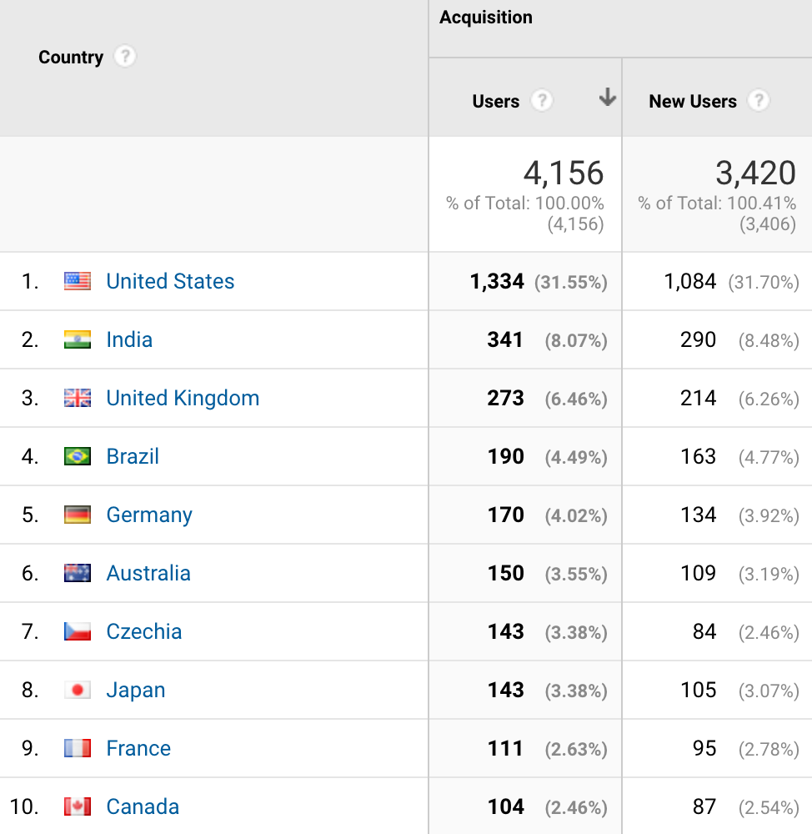
Zowe.org Geos
July 1, 2019
VS
July 30, 2019

Slide 11
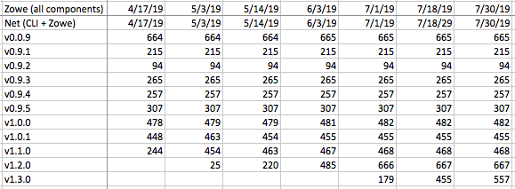
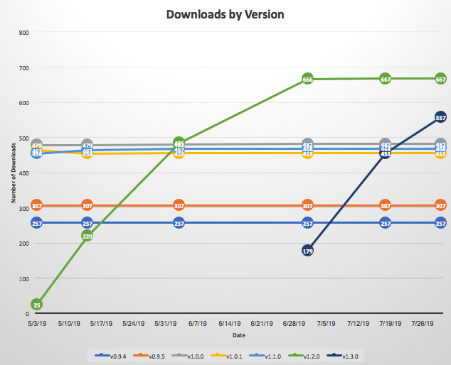
Zowe Downloads
Total Beta Downloads (6 months)
1803
Total v1.x Downloads (6 months)
2629
Cumulative (Beta + v1.X):
4432

Slide 12
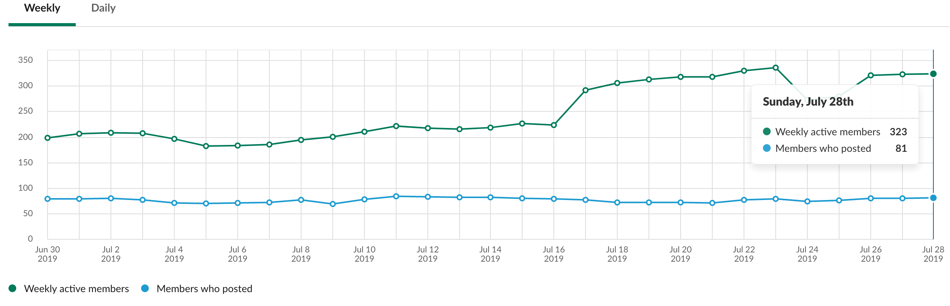
OMP Slack Community Metrics
323 Active Users
+62% vs previous 30 days
1,185 Members
+62 vs previous 30 days

Slide 13
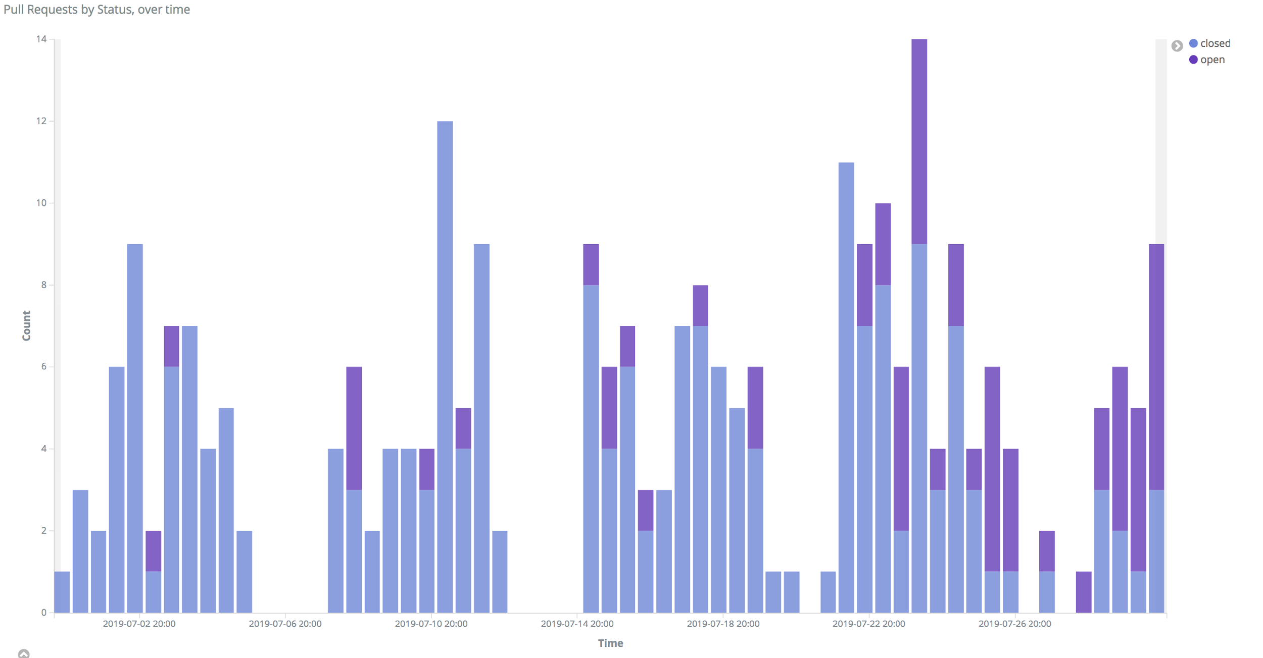
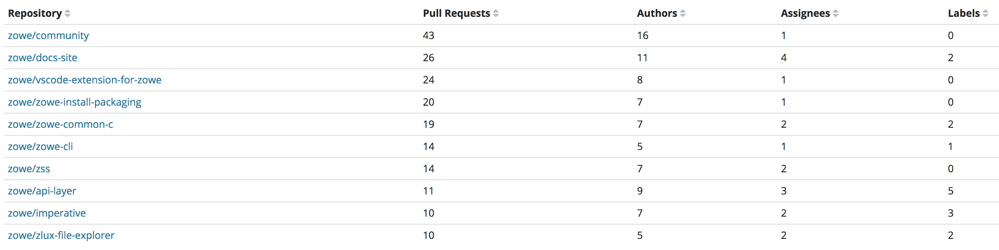
Github PR Metrics
There has been an influx of pull request being issued by a more diverse submitter pool. Spike is explained by the creation of the COMMITTERS.md
Past 30 days
268 Pull Requests (-1% vs prev. 30 days)
65 Submitters (+10% vs prev. 30 days)
35 Repos (-20% vs prev. 30 days)
Cumulative (since 07/31/18)
2,915 Pull Requests
141 Submitters
71 Repositories

Slide 14
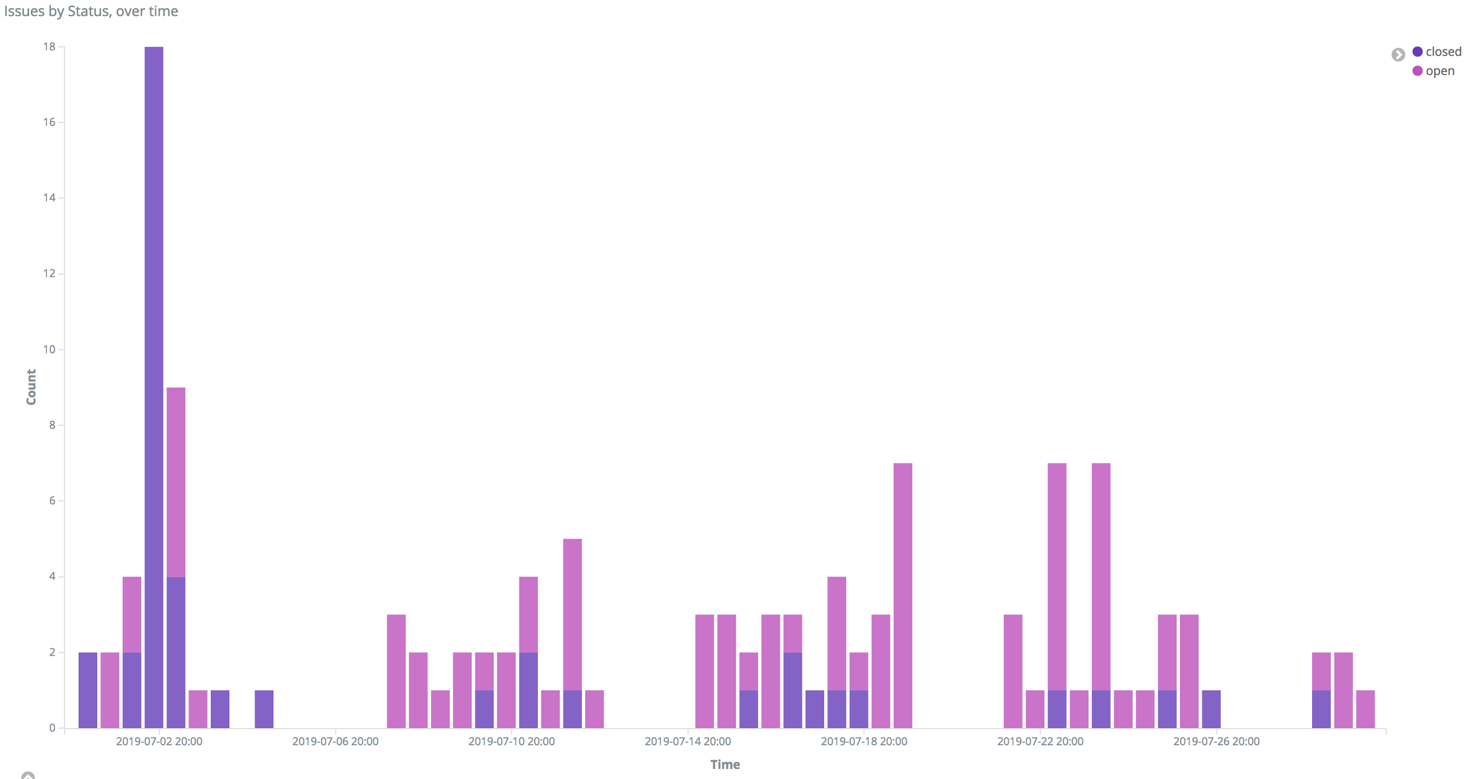
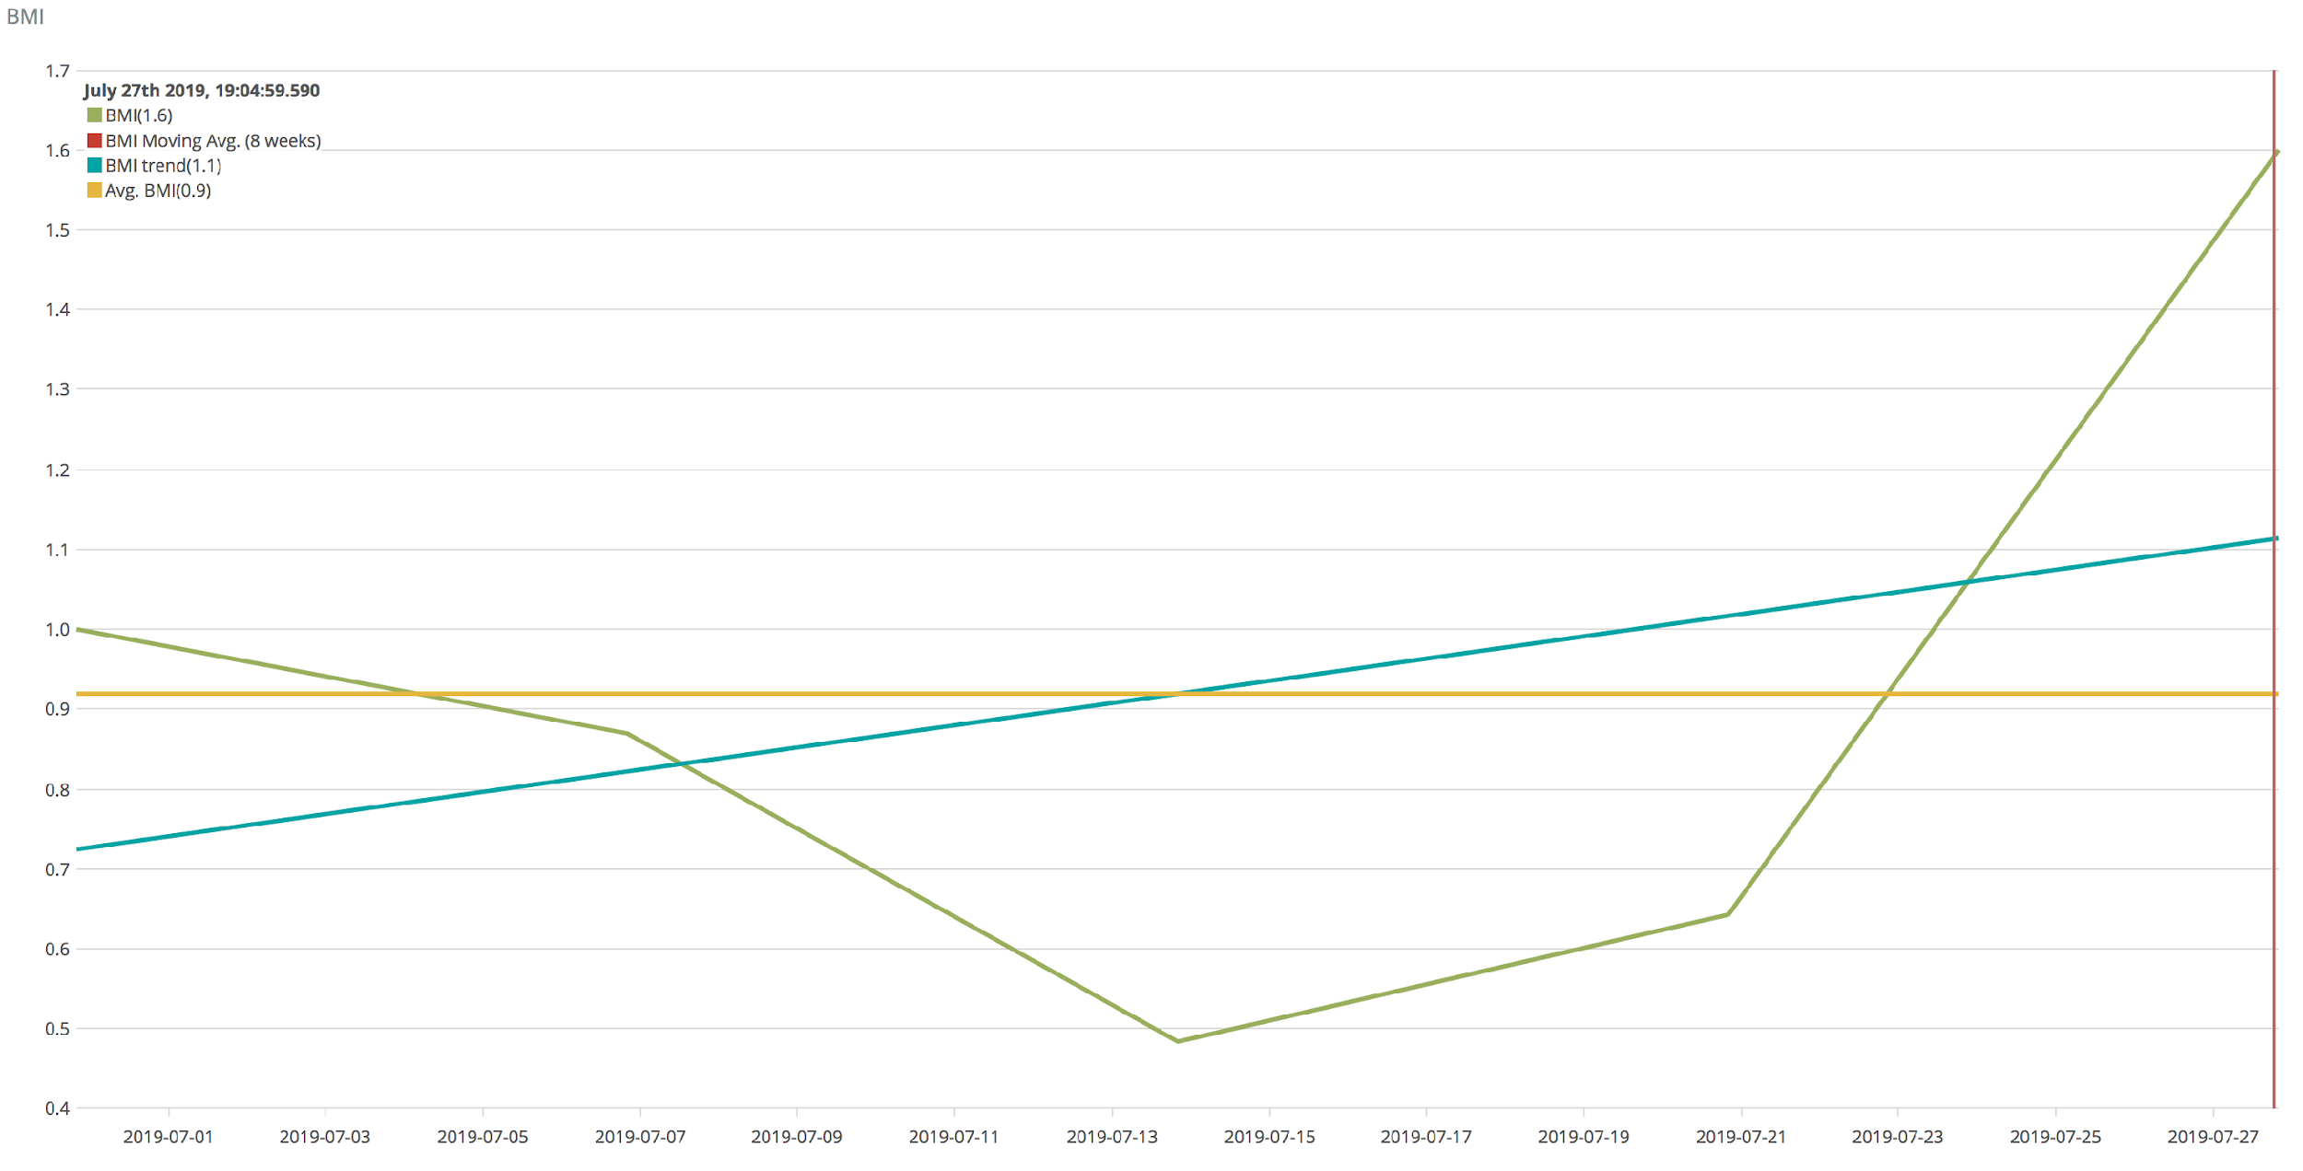
Github Issue Metrics
Current BMI is greater than 1 (currently 1.6), which means the community is closing more tickets than those they are opening.
Past 30 days
125 Issues (-1% vs prev. 30 days)
49 Submitters (+1% vs prev. 30 days)
23 Repos (-1% vs prev. 30 days)
Cumulative (since 7/31/18)
1,940 Issues
155 Submitters
53 Repositories
BMI: Backlog Management Index, defined as the number of closed issues divided by the number of open ones in a given period of time. Measures efficiency closing issues.

Slide 15
SHARE Pittsburgh
Zowe presence

Slide 16
